Slide 1
PROJECT – PECUNIA (Banking System)
Presented By – Aishwarya Sarna

Slide 2
TEAM - F
Team Members –
Aditya
Ayush
Akash
Samanway

Slide 3
EPIC AND USER STORIES
Epic –
Developing Login Page for the bank Employee.
Design a log in dashboard where the employee will login to the system using his credentials.
A “signing in….” indicator will be shown to the user until he logs in, in case of delay.
Need of a database that can scale to accommodate all bank employees.
User Story-
As a bank employee if I type my credentials wrong by accident, I am presented with a pop up that says I need to provide my credentials correctly.
Given I am an employee that has successfully logged in, I want access to manage customers, transactions, loans, etc.

Slide 4
Epic –
As a bank manager, I want to know the customer details.
Know the type of loan the customer has applied for
Calculate the amount of loan
Approve loan
User Story –
As a branch manager I want to view the customer details, including the type of loan the customer has chosen.
As a branch manager I want to choose from the drop down menu, the amount of loan the customer is eligible for.
As a branch manager I want to approve the loan, or reject the loan.
As a branch manager I want to be presented by a pop up window that will say that the customer has been approved for loan successfully.

Slide 5
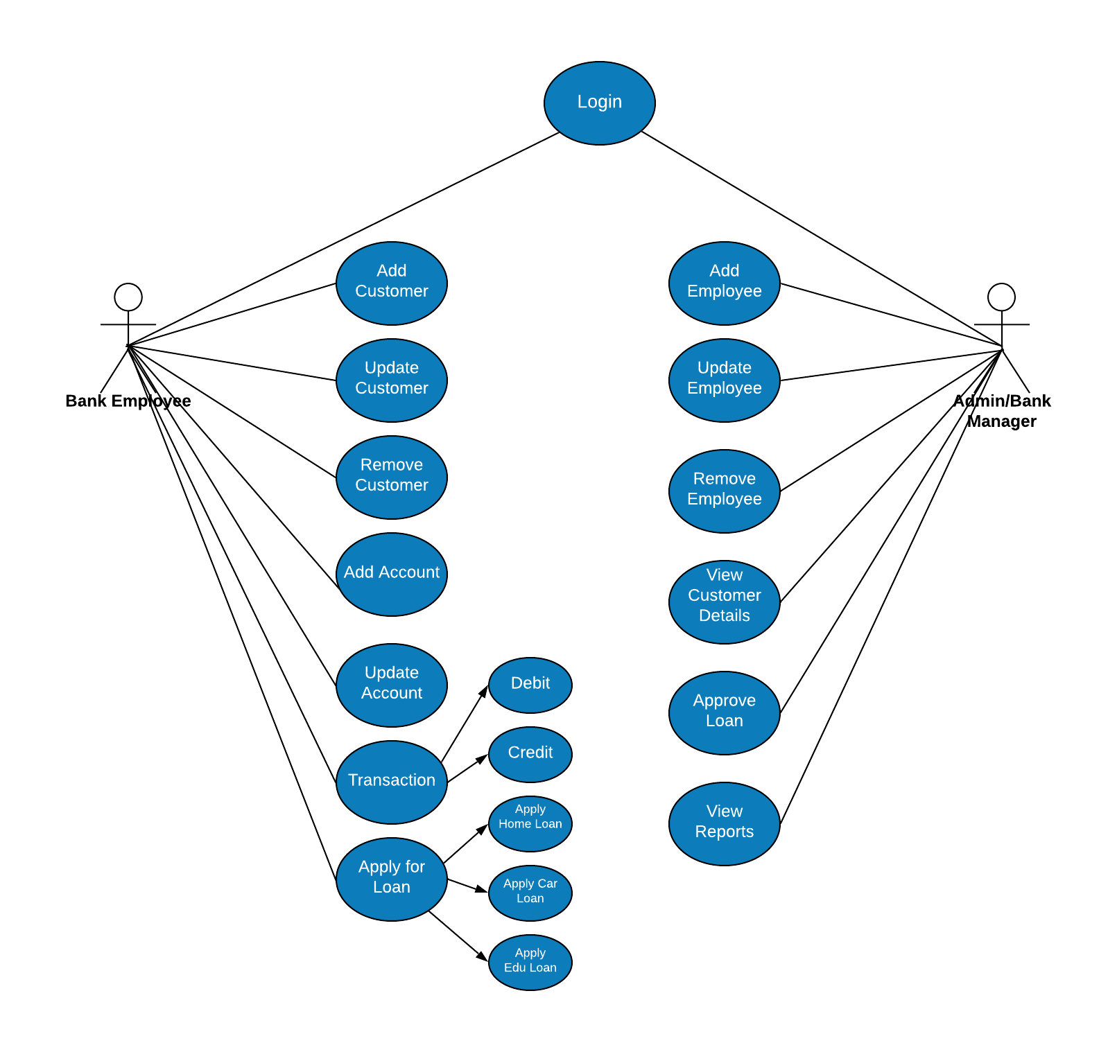
USE CASE DIAGRAM

Slide 6
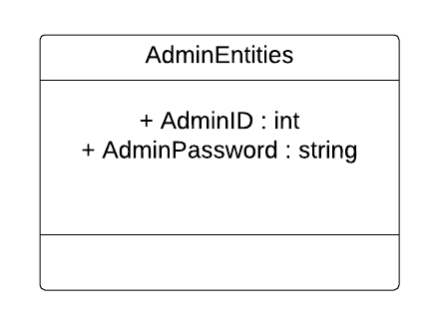
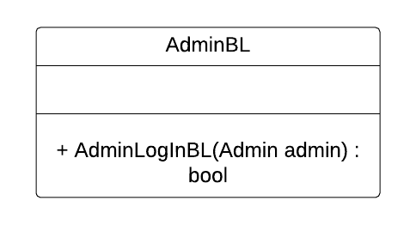
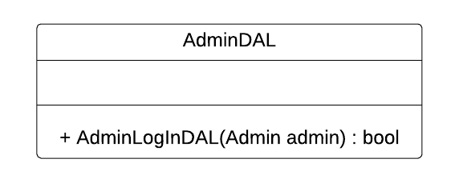
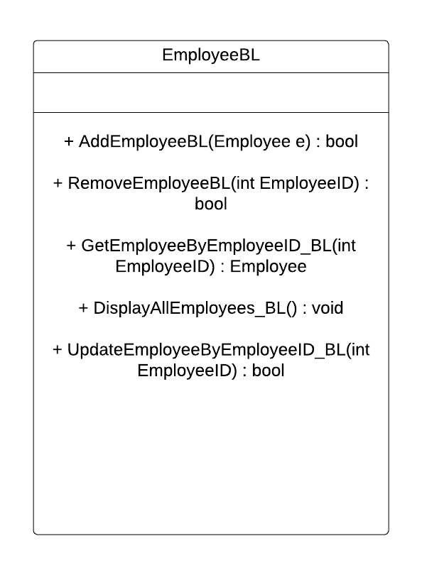
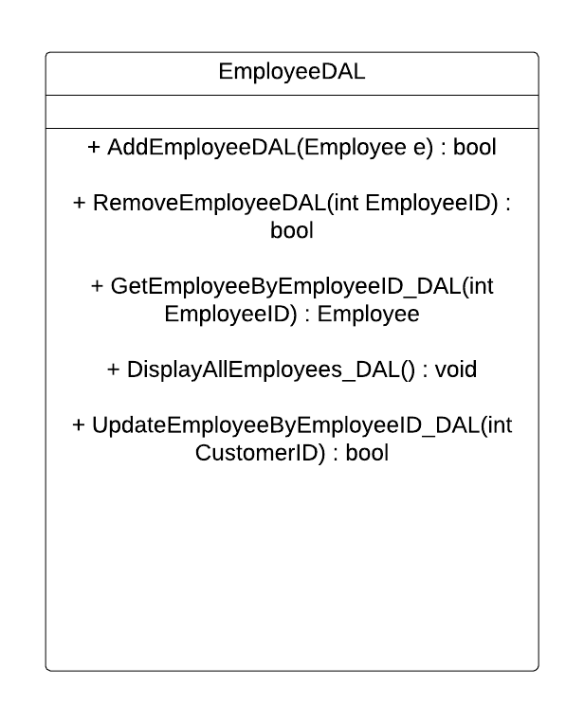
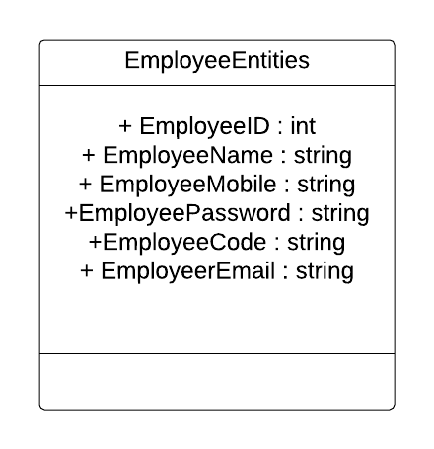
CLASS DIAGRAM

Slide 7
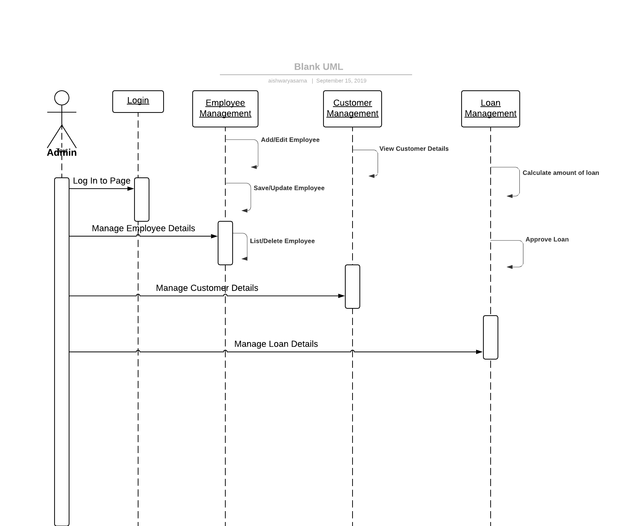
SEQUENCE DIAGRAM

Slide 8
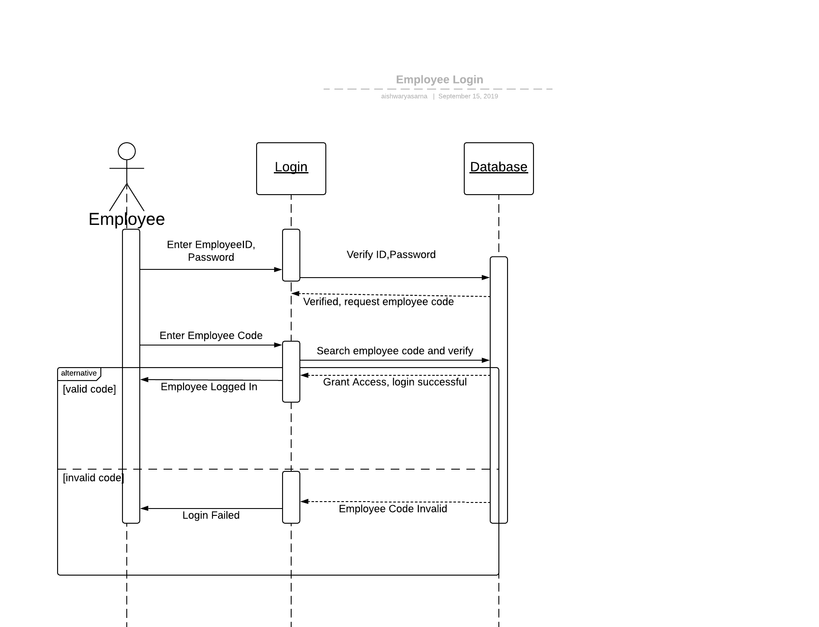

Slide 9
THANK YOU

